Slide 1
205 Oct 26, Class 16
Exam feedback
Scientific writing
Introduction: framing the question
Discussion: drawing inferences
Expanding the background research

Slide 2
Exam feedback
Question 1. Studying double-speed. During the pandemic, many professors distributed recordings of their previous lectures so that students could learn at their own pace. When this happens, some students reported preferring to watch the lecture at faster than original speeds, but it is unknown how this might affect how effective learning is.
Murphy et al. (2021) conducted a study in which participants watched the same lecture video at different speeds. A group of 110 students were recruited and randomly assigned to either watch the video at 1x speed (Group A) or to watch the video at 2x speed (Group B). Group B then watched the video a second time. After watching, both groups took a test based on multiple-choice questions to measure their comprehension of the video content. The test was graded out of 100 points. (5 pts each; 35 points total)
(f) Although the main hypothesis was about video playback speed, there is an alternate way to explain the findings. Give the alternate hypothesis. Then give a statement defending the finding and arguing in favor of a conclusion based on playback speed and comprehension.

Slide 3
Definitions
An error where the experimenter incorrectly claims that the independent variable affected the dependent variable when there was no reliable effect.
A control technique for anything that cannot be kept constant in the experiment, keeping this factor from being confounded with the independent variable.
The term for the procedure when experimenters do not inform the participants about the hypothesis or the other condition in a two-group independent sample study.
The section of an APA-style research report where you present the main findings of the study, including the results of the statistical analyses.
A positive effect of a simulated treatment that lacks any active ingredient other than participants’ expectations about the treatment
The name of the department that reviews formal research for compliance with principles of research ethics
The process of participants indicating that their participation in research is entirely voluntary and with knowledge of all the risks and potential benefits of the study
When participants’ responses across multiple conditions are affected by the order of conditions to which they were exposed.
When an experiment is designed carefully so that there are no confounds that would lead to alternate explanations, we say the experiment has this
The degree to which the measure used in the experiment visible relates to the underlying construct meant to be measured.

Slide 4
Question 3. Blaming the victim. In Dawtry et al. (2020), the researchers explored a phenomenon in which participants tended to judge crime victims more harshly when they saw a more emotional presentation of the crime. Participants were exposed to a victimization scenario that was presented either as a relatively dry third-person written text vignette (description) or watching an engaging video taken of the crime as it actually took place. They were then asked to rate the character of the victim 0-10.
(d) Describe a participant-based extraneous variable (something that differs across people) that might influence the DV in this design. If participants were randomly assigned to conditions, would this potentially confound the experiment? What might go wrong?
(e) In preparing stimuli for this study, we might employ a measure used as a “manipulation check” for crime videos and the associated text descriptions of the crime. Given the original hypothesis motivating this experiment, what would we measure about these potential new stimuli and why?

Slide 5
Writeup #2
Include both Experiment 1 and Experiment 2
Methods for Experiment 2 available on Canvas
Make corrections to Experiment 1
Expand the Introduction
What is “deep” encoding?
Why do we hypothesize that “deep” encoding leads to better memory?
Expand the Discussion
Summarize results of both experiments
What do they mean with respect to the hypothesis?
Refer back to theory from the Introduction

Slide 6
Multi-experiment papers
Abstract
Introduction
Experiment 1
Method
Results
Discussion (short, segue)
Experiment 2
Method
Results
Discussion (optional)
General Discussion
References

Slide 7
Formatting details
References
Figures & Captions
Pagination
Title
Abstract
Double-spaced

Slide 8
Writing with Style
Reading published work focused on style
How they communicate instead of what
Using Google Scholar
Search by keywords
Find @ NU
Cite & Cited by links
Peer-reviewed journals
Avoid “Proceedings”

Slide 9
Introduction sentences
Sentence indicating the purpose of the study from last 2 paragraphs of Introduction.
Find sentences that indicate why this is an important research topic.
Sentences at the end of the Introduction that signal information about methodology.

Slide 10
Understanding decisions to express support could therefore provide a critical theoretical contribution to the emerging literature on barriers to prosocial actions, as this understanding could provide evidence for a key boundary condition on an otherwise robust psychological tendency.
It could also be of meaningful practical value, given that decisions to express or withhold support likely happen when recipients are most in need and hence may be especially beneficial for recipients’ well-being.

Slide 11
Finally, Study 4 tested a prediction from our theory that a perspective gap is one mechanism for explaining why expressers underestimate the positive impact of their support. Specifically, we tested whether expressers tend to focus on how competently they can express support, whereas recipients focus relatively more on the warmth the support conveys

Slide 12
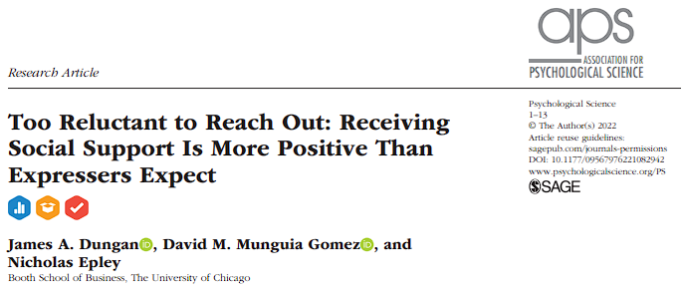
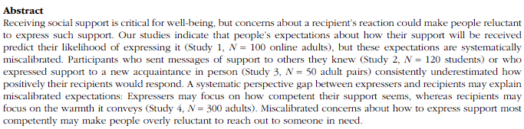

Slide 13
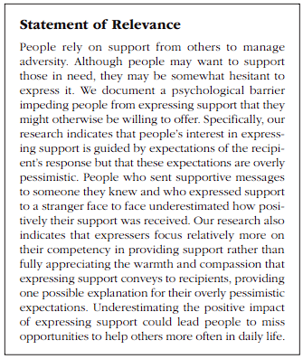
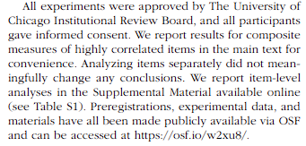

Slide 14
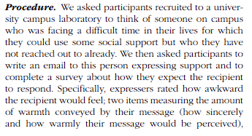
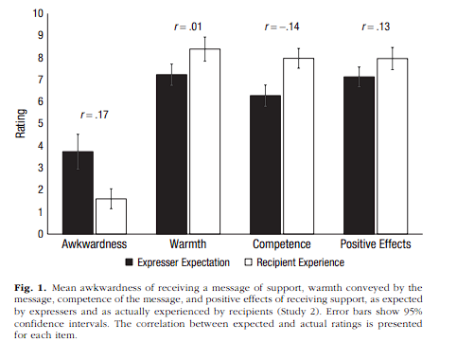

Slide 15
Discussion Sentences
Statements of similarity or difference between this work and that of previous researchers or works by the same author
Comments that refer to theories referred to in the Introduction

Slide 16
These results further suggest that people may think too narrowly about whom they can support. The relationship between expresser and recipient strongly influences expectations of how effective and appropriate support is (Lakey & Orehek, 2011; Rafaeli & Gleason, 2009; Veenstra et al., 2011), but Studies 2 and 3 suggest that these expectations may be misleading
These results are consistent with those of recent work demonstrating that rewarding social interactions are not confined to close others: Mere acquaintances are surprisingly effective at providing support (Small, 2017) and increasing well-being more generally (Epley & Schroeder, 2014; Sandstrom & Dunn, 2014a, 2014b).

Slide 17
Our studies suggest that even when people recognize that support is needed, they may be overly reluctant to express it because they hold miscalibrated expectations of their recipients’ response. Expectations of how their support would be received predicted expressers’ willingness to express it (Study 1), but these expectations were overly pessimistic with regard to both friends and strangers (Studies 2 and 3).

Slide 18
For Fri 10/28
Writeup #2 due
APA format report for Experiments 1 and 2
Due Friday, accepted through Sunday
Monday: Chapter 13, Developing a Research Proposal

